Slide 1
Framing the Protests:
Headline Examples

Slide 2
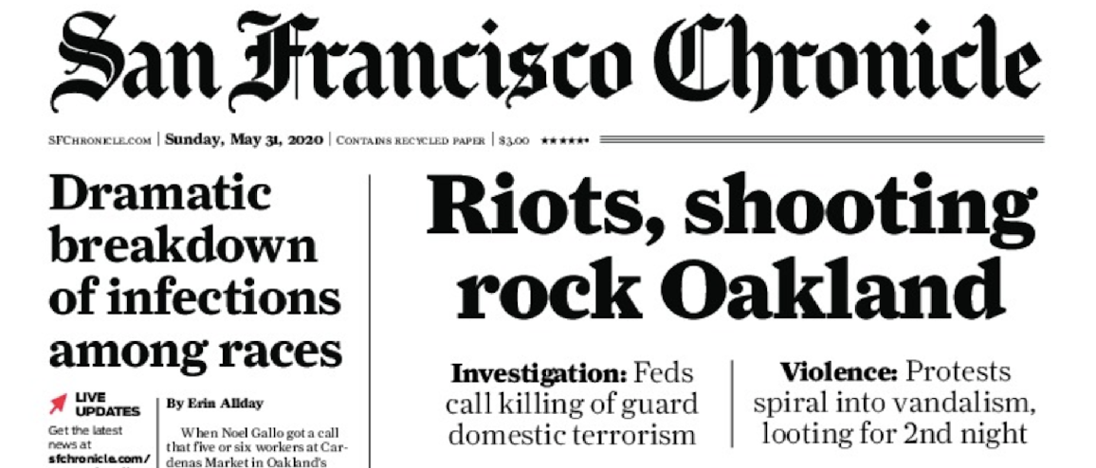
San Francisco Chronicle, May 31, 2020
https://twitter.com/sfchronicle/status/1267097267950903305

Slide 3
The National Post, June 1 2020
https://nationalpost.com/news/fires-burn-near-white-house-in-violent-u-s-protests-2#Echobox=1591016401

Slide 4
Slate, May 31, 2020 https://slate.com/news-and-politics/2020/05/george-floyd-protests-police-violence.html

Slide 5
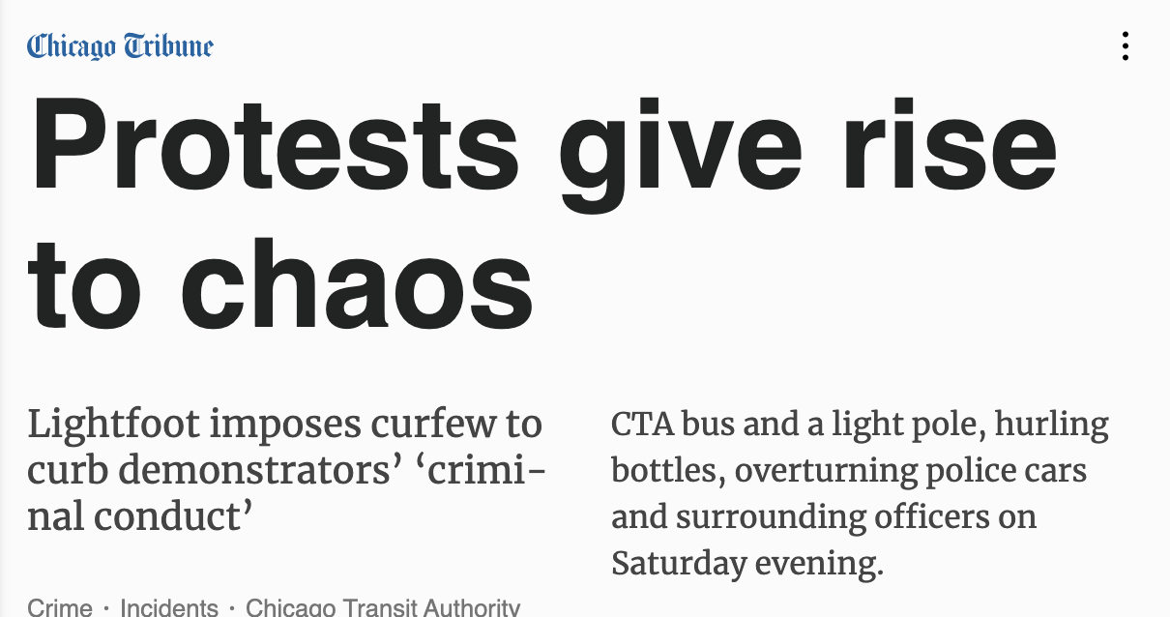
Chicago Tribune, May 31, 2020
https://www.pressreader.com/usa/chicago-tribune-sunday/20200531/282398401632734

Slide 6
The Globe and Mail, June 1, 2020
https://www.theglobeandmail.com/world/us-politics/article-record-number-of-curfews-national-guard-called-in-as-violence-grows/

